Slide 1
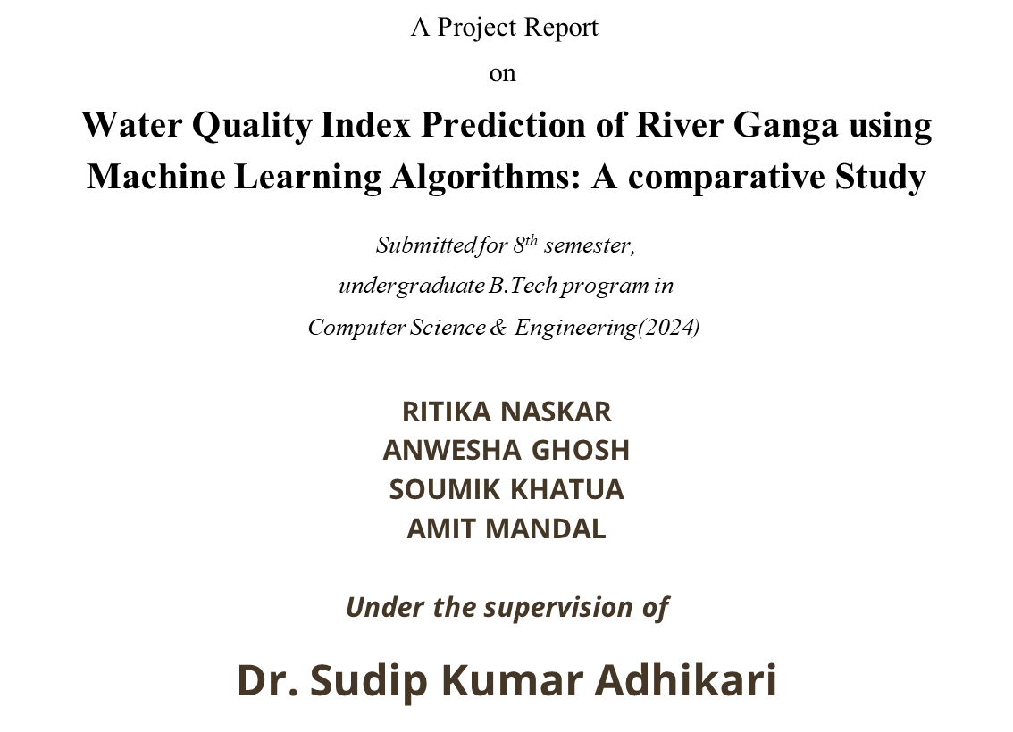


Slide 2


Water Quality Index Prediction of River Ganga Using Machine Learning
Welcome to our project where we use machine learning models to predict the water quality index of the River Ganga. The river has great religious, cultural and environmental significance and hence it's crucial to ensure its purity.

Slide 3
Introduction
Ganga River is considered the most prominent river of India. As we know this river faces certain environmental challenges like sewage disposal, dams & water extraction etc. To provide the benefits of challenges water quality classification is required. After classification of water quality we can make a robust warning system which will address water quality issues for awareness.
Here we are going to create a machine learning model which will predict the quality of the Ganga river water where the measuring parameters dataset is collected from the website of the Central Pollution Control Board.
The goal is to provide a concise representation of water quality, for spreading awareness in local initiatives, control environmental management, and public health.

Slide 4
Objectives
We’ve studied a research paper named, “Evaluation of water quality index for River Sabarmati, Gujarat, India” by Kosha A. Shah Geeta S. Joshi for a comparative study of river Ganga to measure its water quality and label whether it is good for human consumption or not. This study uses the Water Quality Index (WQI) to predict the water quality classification.
The main aim of this project is to implement the machine learning model according to the applied algorithms and determine which machine learning algorithms' performance is more accurate indicating it perfectly predicts the water quality classifications in the testing set.
We aim to develop a predictive model for the River Ganga Water Quality Index. By leveraging machine learning algorithms, we intend to establish a robust system that can forecast water quality levels based on relevant environmental parameters.

Slide 5
Water Quality Index (WQI)
The water quality index (WQI) is one of the most used tools to describe water quality. It is based on physical, chemical, and biological factors that are combined into a single value that ranges from 0 to 100 and involves 5 processes:
(1) parameter selection
(2) Development of a rating scale to obtain the rating (Vr)
(3) considering the weightage of each parameter (Wi)
(4) Determining the subindex value (Wi x Vr)
(5) Aggregation of sub-index values to obtain the overall WQI
The Water Quality Index uses six parameters: BOD, DO, Conductivity, pH, and E.coli. Nitrate. To obtain the WQI value, all parameters must first be converted into subindices (SI), namely SIBOD, SIDO, SIEC, SIpH, SIN, and SIE.coli. Then, WQI was calculated by substituting all sub-indices of the six parameters into the WQI formula.

Slide 6
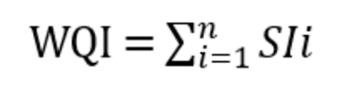
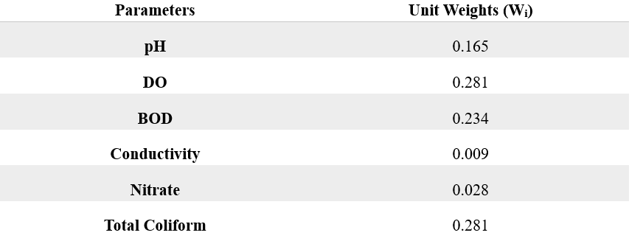
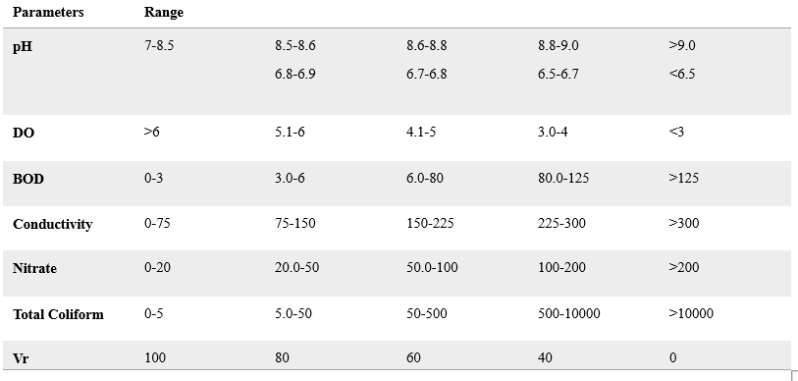
Where WQI is the Water Quality Index. n is the number of water quality parameters
Where “SIi” is the subindex rating,
SIi = Wi × Vr
“Wi” is the unit weight, "Vr” is the rating that can be obtained from a rating scale based on all the parameters
Wi Table
Vr Table

Slide 7
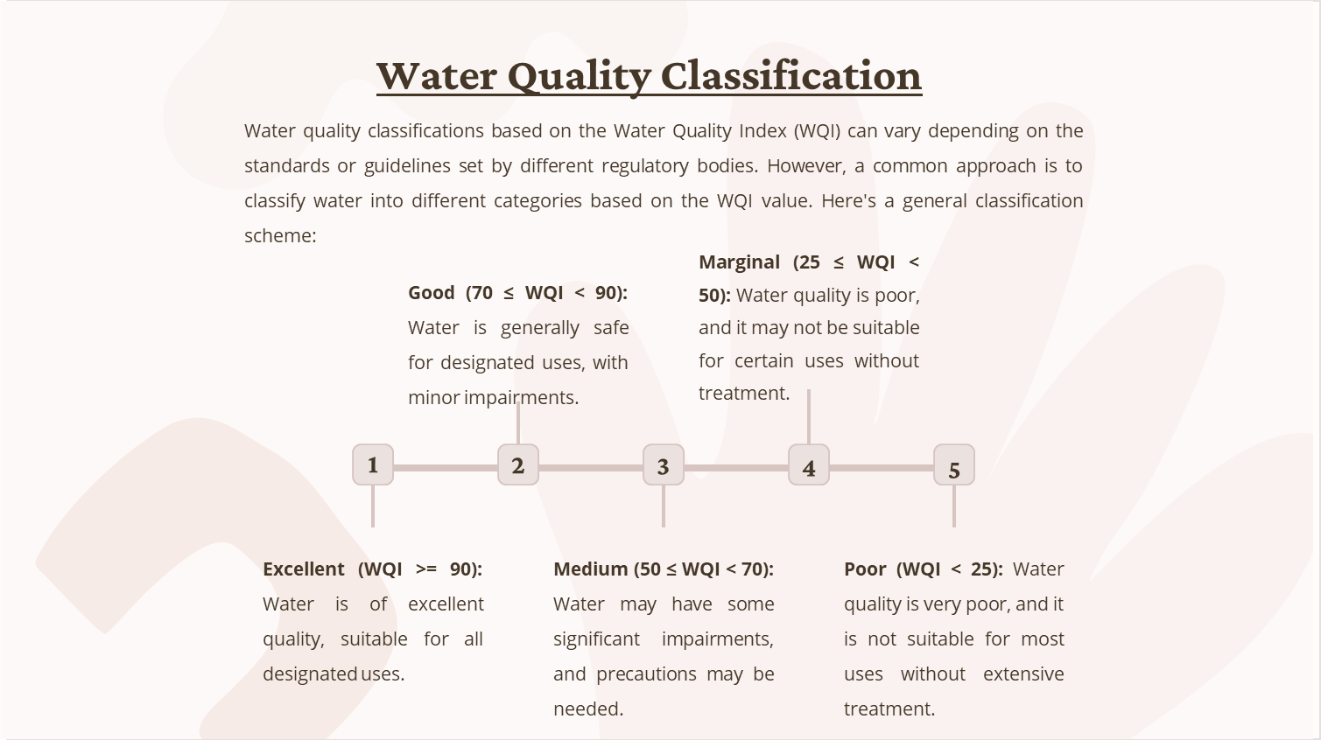

Slide 8
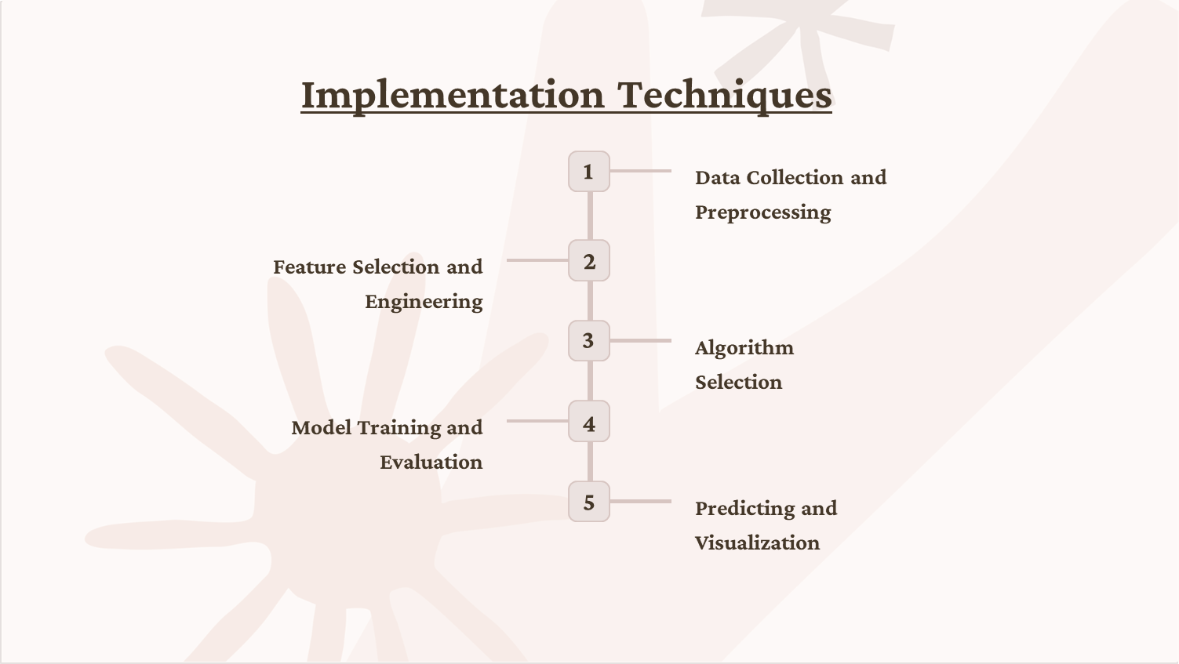

Slide 9
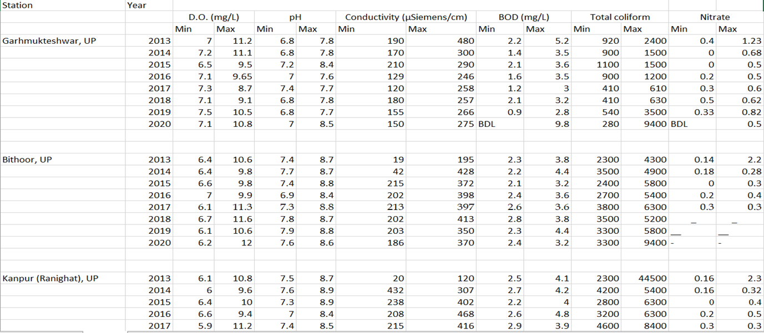
Dataset
Step I: We have collected the dataset of river Ganga from the Central Pollution Control Board website.
Here we have taken 16 stations from different states of 8 years 2013-2020 data.

Slide 10
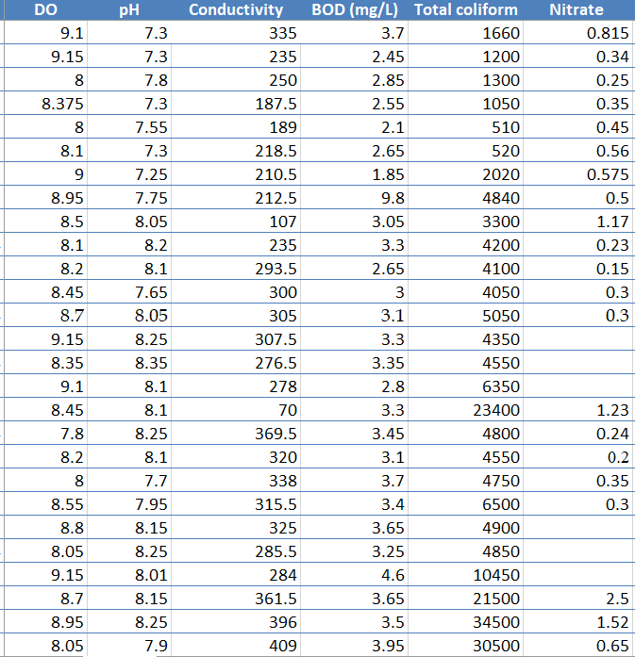
Final Data frame after Extract & Cleaning
Step II: Data set extraction
Now structurally took the dataset on a Separate Excel Sheet and made a Final Datasheet. Then we import that Final Dataset on Colabortory for further experiments. We remove the unnecessary rows and columns to extract the actual dataset that will give the results.

Slide 11
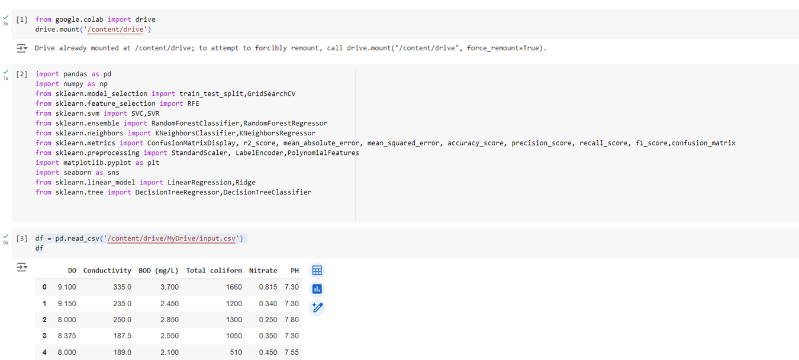
STEP III– Dataset upload on Colab & print the data frame:
First, we’ve to convert the Excel sheet to a .csv file and then upload it on Google Drive. After uploading the file, we open the Colab Library and print the dataset

Slide 12
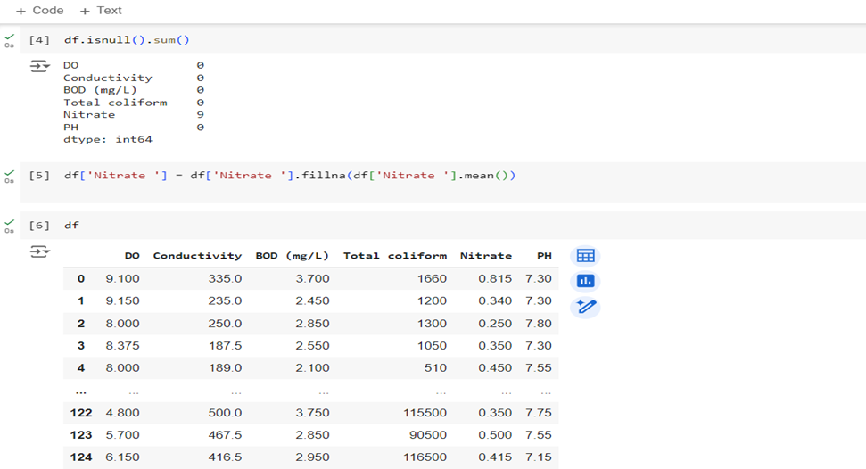
STEP IV- replace the missing values by the mean value of the parameter:
First, we checked how many missing values are there in the data frame. Then we remove the missing values with the mean values of the parameter. After replacing the missing fields

Slide 13
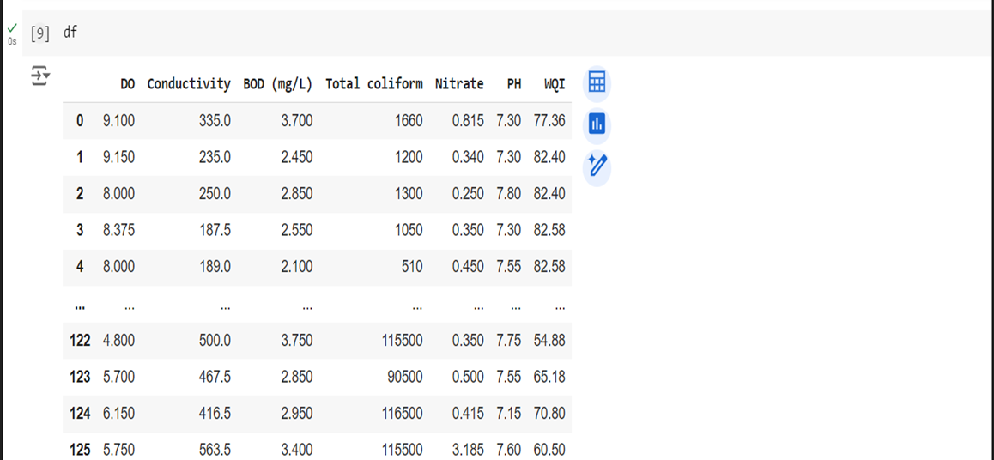
STEP V - print WQI Values for each row:
Here, we get all WQI values for each row according to the WQI formula we described above.

Slide 14
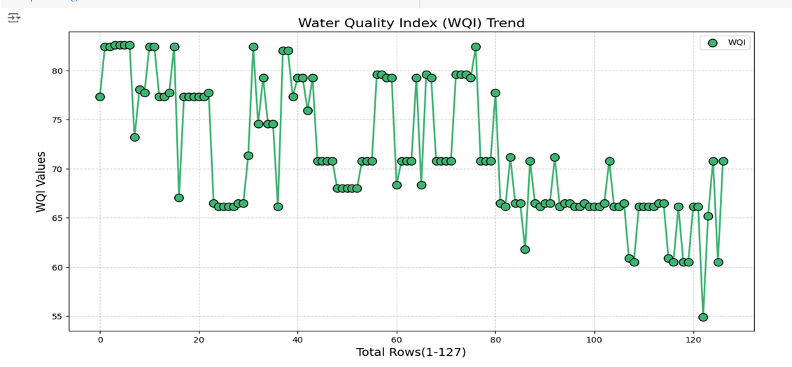
Here, we obtained the graph of WQI values for each row.
After WQI calculation, we obtained the water quality is increased in Uttar Pradesh and decreased in West Bengal.

Slide 15
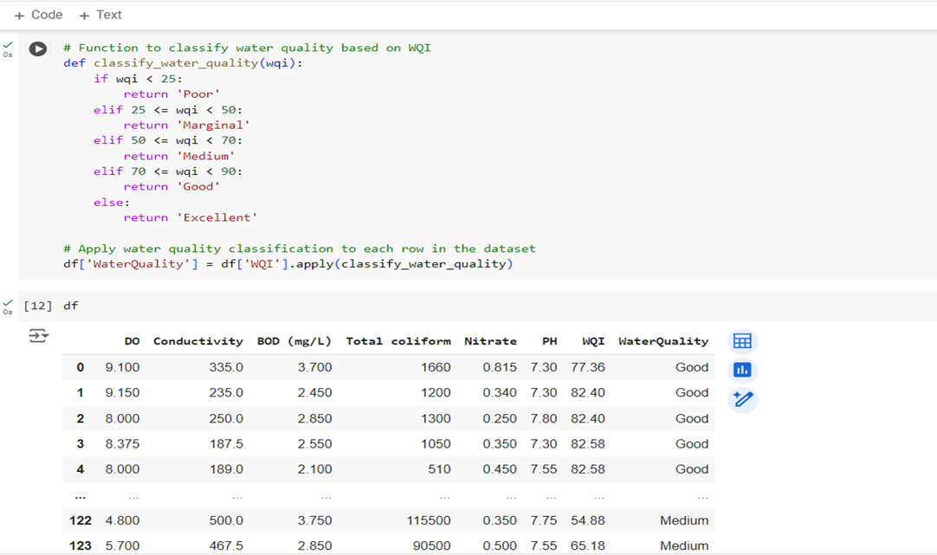
STEP VI – print the function to classify water quality based on WQI
Now, we can classify the quality(fair, good, marginal, poor) of the water based on the above WQI values.

Slide 16
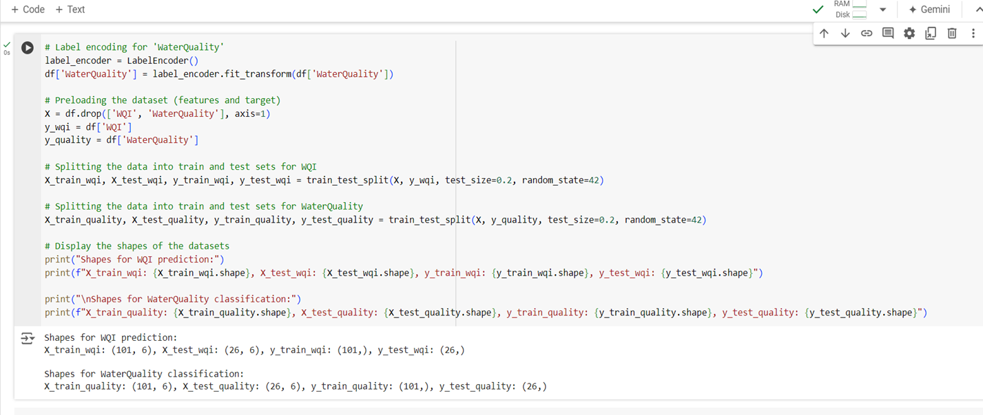
STEP VII– Splitting the dataset into feature & target variables
Here, we split the dataset into two datasets- i) Training Dataset, ii) Testing Dataset.
We take 80% of the actual dataset for training and 20% is used for testing.

Slide 17
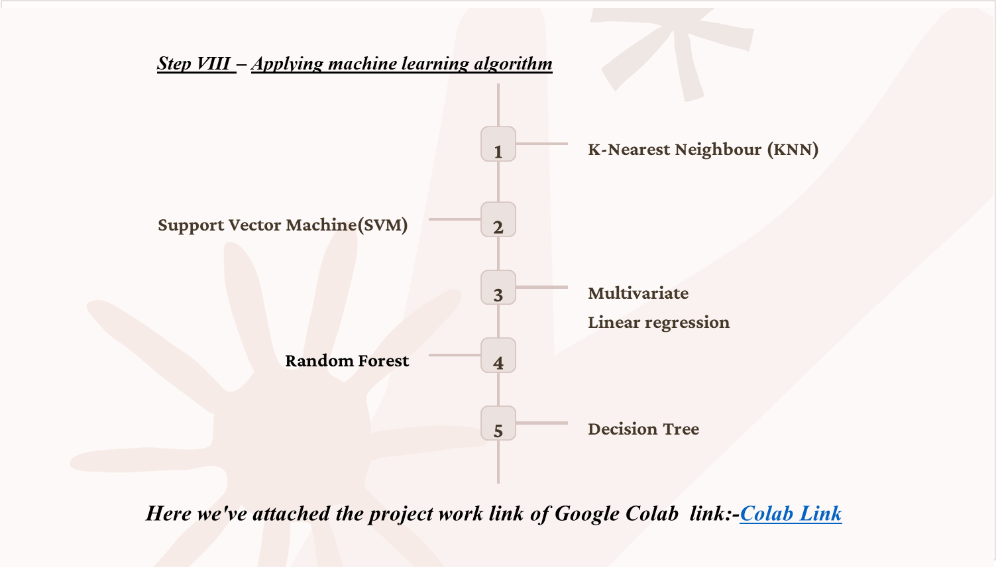
Step VIII – Applying machine learning algorithm
Here we've attached the project work link of Google Colab link:-Colab Link

Slide 18



Different Evaluation Metrics
Evaluation Metrics
For Regression
For Classification
R2 Squared
Accuracy
Precision
MAE
Recall
MSE
F1 Score

Slide 19
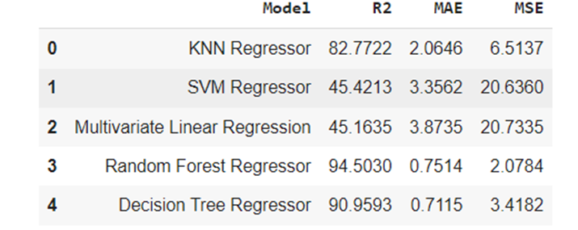
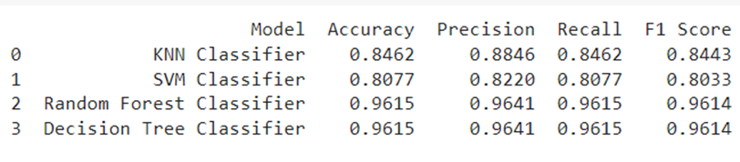
Analysis
Here we obtained model performance criteria of all the ML Algorithms based on the specific parameters like classification (Accuracy, Precision, Recall, F1 Score) and regression (MAE, MSE, R2 Squared) metrices.
Based on the testing metrics, the Random Forest Classifier is the best model for water quality classification in our dataset

Slide 20
Conclusion
In our complete analysis of Water Quality prediction, we have obtained the error calculation between the predicted and actual value of the Water Quality Index and we can predict which algorithm best suits our collected dataset.
In conclusion of the complete water quality index calculation, we can label water quality as good and medium. From which we can tell that the water is used for human consumption.
After getting the most accurate result of the specific algorithm, any organizations (state & central government) can make Water Quality Index Calculator using web development. WQI calculators can be designed to update water quality data regularly based on new data, ensuring that the predictions remain accurate and relevant over time.

Slide 21

Thank You

